Slide 1

Packages

Slide 2

Exam Objectives
Create and import packages

Slide 3
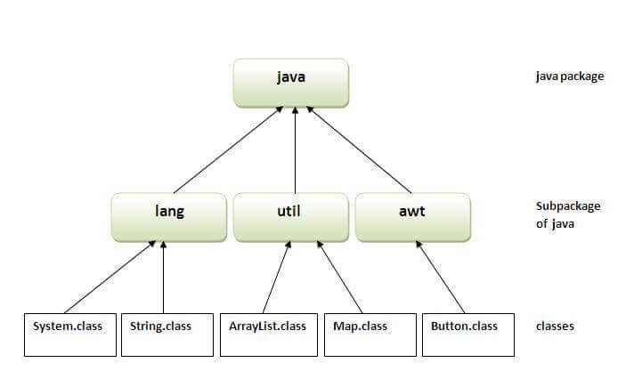
More about packages…
Package statement is the first thing to write in a java program.
Package naming convention : Reverse domain name format. This is the preferred way otherwise package name can be anything.
In order to use a java class from a different package we make use of import statement.
If two classes lie in same package then they do need to import each other .Only different package classes need to imported.
Multiple/Single file import usage.
If we don’t specify a package statement , the class is assumed to be in a default package.
Importing default package is not possible as import *;
Using fully qualified name in case of same class name.
Java.lang package in the java APIs is automatically available to all java program without explicitly importing it.
Code Examples : org/java/imports/PackageAndImports.java

Slide 4
Static Imports
The static member of a class are accessed using fully qualified class name. In cases where there is a heavy usage of static members of a class , static imports come to the rescue.
Once a class is imported statically , then we do not need to use the fully qualified name of the class. Instead we can just use the members of imported static class as they were the member of the importing class.
Ex: org.java.staticImports package.

Slide 5

Java File/Class Naming
Example : Postal addressing system

Slide 6

Questions ??
a b c

